Slide 1
Chapter 4
The Service Encounter
where service is evaluated
Each moment of truth is an opportunity influence the customer’s perceptions of the service quality.

Slide 2
Learning Objectives
Describe the five roles of technology in the service encounter.
Use the service encounter triad to describe a service firm’s delivery process.
Differentiate four organizational control systems for employee empowerment.
Prepare abstract questions and write situational vignettes to screen service recruits.
Describe the classification of customers into four groups based on their attitudes and expectations.
Describe how the creation of an ethical climate leads to job satisfaction and service quality.
Discuss the role of scripts in customer coproduction.
Describe how the elements of the service profit chain lead to revenue growth and profitability.

Slide 3
Moments of Truth
Each customer contact is called a moment of truth.
Moment of Truth
  關鍵時刻 Jan Carlzon
  SAS CEO, Scandinavian Airlines System
a moment in time, when the customer is
  evaluating the service
  forming an opinion of its quality
An airline passenger
    a series of encounters
  Searching flights, buying tickets, boarding pass, luggage check-in, inflight service, baggage claim, award the frequent flyer credit...

Slide 4
Moments of Truth
7-<number>
Reference http://wiki.mbalib.com/zh-tw/%E5%85%B3%E9%94%AE%E6%97%B6%E5%88%BB
關鍵時刻(Moments of Truth，MOT)這一理論是由北歐航空公司前總裁詹·卡爾森創造的。他認為，關鍵時刻就是顧客與北歐航空公司的職員面對面相互交流的時刻。這個時刻決定了企業未來的成敗。
卡爾森總裁提出：平均每位顧客，會與五位服務人員接觸；在平均每次接觸的短短15秒內，就決定了整個公司在乘客心中的印象。如果每一個MOT都是正面的，那麼客戶就會更加忠誠，為企業創造源源不斷的利潤。
卡爾森發覺，在每一次的關鍵時刻中，都有機會將消費者的印象經驗由好轉壞、從壞變好，而其中關鍵就在於「人」；提供給您當下服務的「那一個人」！

Slide 5
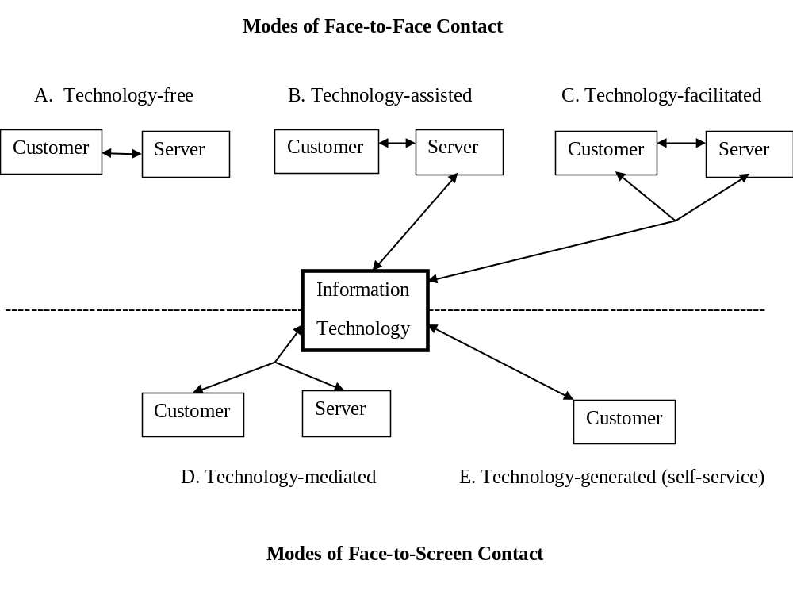
Figure 4.1: Role of Technology in the Service Encounter
Advance in ICTs have a profound effect on ways customers interface with service providers.
5 modes of technology’s contribution to the service encounter.

Slide 6
Modes of face-to-face contact
A. Technology-free service encounter
  Traditional high touch service
  Customer is in physical proximity to and interact with a human service provider
    Personal care & professional services: hairdresser, chiropractor, law, consulting, psychiatry therapy
B. Technology-assisted service encounter
  Only the service provider has access to the technology to facilitate the delivery of face-to-face service
    Health care procedures: ie full mouth x-ray exam at the dentist
    Airlines: check-in counter, use computer terminal to check in passengers
C. Technology-facilitated service encounter
  Both customer and service provider have access to the same technology (co-location required)
    Financial planners in consultation with clients on a computer to illustrate returns and risks.

Slide 7
Modes of screen-to-face contact
D. Technology-mediated service encounter
  Both customer and service provider have access the same technology (without co-located physically)
    Getting technical help from a distant call center, automobile remote monitoring service: use GPS to reassure motorists that assistance is on the way.
E. Technology-generated service encounter
  The human service provider is replaced entirely.
  This mode is becoming more common as firms attempt to reduce the cost of providing service.
    Customer self service, ATM, check-out scanning, airport check-in kiosks…

Slide 8
The Emergence of Self-Service
Driving forces for self-service
  Service provider: elimination of labor costs for nonproductive activity
  Customer: increased opportunity for customization, accuracy, convenience, and speed
Social implications of the increasing of self-service
  Low wage, unskilled service jobs are bound to be replaced by self-service technology
  Growth in service jobs will be limited to highly skilled (ie healthcare), intellectual (ie professional), creative (ie entertainment) pursuits.

Slide 9
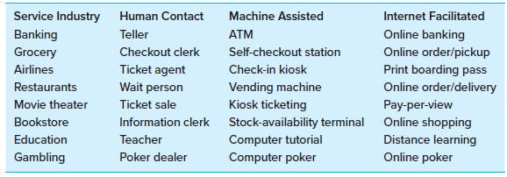
Table 4.1: Evolution of Self-Service
For example, the introduction of ATMs by banks saved teller costs but also provided customers with place-and-time convenience.

Slide 10
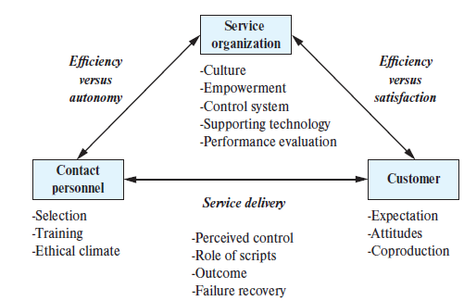
The Service Encounter Triad
Every MOT involves an interaction between a customer and a service provider, each has a role to play in an environment staged by the service organization.
Figure 4.2 captures the relationships between the three parties and suggests possible sources of conflict.

Slide 11
The Service Encounter Triad
Balance the need for control of three parties
    create a beneficial service encounter
  Service organization: efficiency
    Interest in delivering as efficient as possible to protect their margins and remain competitive.
  Contact personnel: autonomy
    Interest in control customers’ behavior
      Make their work more manageable and less stressful
  Customer: satisfaction
    Attempt to gain control to derive the most benefit from the encounter.

Slide 12
Balance of control
A satisfactory and effective encounter should balance the need for control by all three participants.
The organization’s need for efficiency can be satisfied when
  contact personnel are trained properly &
  the customer’s expectations and role in the delivery process are communicated effectively.

Slide 13
  Encounter dominated by service organization
    To be efficient, to be cost leadership
      Standardize service delivery
        SOP
      Limit discretion of contact personnel
        everything go “by the book”
      Limit choices for customers
    McDonald’s
      Structural organization and environment
      Teaching customers what not to expect

Slide 14
Efficiency versus autonomy
  Contact personnel dominated encounter
    Service personnel attempt to limit the scope of the service encounter to reduce their own stress in meeting demanding customers.
    Contact personnel in an autonomous positions, perceive themselves as having a significant degree of control over customers.
      Customer is expected to place considerable trust in the contact person’s judgement because of the service providers’ perceived expertise.
      Physician and patient best illustrates the shortcomings of the contact personnel-dominated encounter, where patient is placed in a subordinate position with no control over the encounter.

Slide 15
Efficiency versus satisfaction
  Customer dominated encounter
      For standardized service, self-service is an option that gives customers complete control over a limited service that is provided.
        ie self-service gasoline station, the result can be very efficient and satisfying to the customer who needs very little service.
      For a customized service, ie legal defense in a criminal case, all of the organization’s resources might be needed, at great cost in efficiency.
      The online encounter is an increasing popular variation where the contact personnel is replaced with a website. Design a website that will attract repeat customers is a challenge for the service organization.

Slide 16
The Service Organization
The service organization establishes the environment for the service encounter.
Culture: pattern of beliefs and expectations that is shared by the organization’s members and produces norms that powerfully shape the behavior of individuals or groups in organizations.
  ServiceMaster
    hospitals housekeeping provider (company’s name embodied its value of “Service to the Master”)
  Disney (Choice of language: Casting)
    Show business terms used to remind employees that Disney is in the entertainment business, employee is “cast member”
  Federal express
    “absolutely positively overnight”
    Communicate by many extraordinary employee feats to safeguard the service guarantee

Slide 17
Organizational Culture: example reference http://panmore.com/starbucks-coffee-company-organizational-culture
7-<number>
Features of Starbucks Coffee’s Organizational Culture
Starbucks describes its organizational culture as a culture of belonging, inclusion and diversity.
Combination of these characteristics is unique to the firm.
The main features of Starbucks’ organizational culture are:
  Servant Leadership (“employees first”)
  Relationship-driven approach
  Collaboration and communication
  Openness
  Inclusion and diversity

Slide 18
Starbucks Coffee’s Organizational Culture
7-<number>
Servant Leadership.
  The employees-first approach. Former Starbucks President Howard Behar believed that employees who are cared for are the ones who care about customers.
Relationship-driven Approach.
  supports warm and friendly relationships.
Collaboration and Communication.
  encourages collaborative efforts through effective communication. They collaborate as teams to make the order fulfillment process efficient.
Openness.
  former Starbucks President Behar introduced open forums to encourage employees to ask questions and communicate with superiors.
Inclusion and Diversity.
  An anti-discrimination policy. Starbucks facilitates sharing and rapport among employees, as well as innovation based on diverse ideas.

Slide 19
Service Organization: Empowerment
Empowerment begin by trusting unconditionally the inherent power within employee to evaluate choices and competently execute creative decisions.
A new model supported with technology has inverted ‘T’ organizational structure, where layers of supervision are significantly reduced because contact personnel are well trained, motivated, and supplied with computer-based timely information.
  i.e. Taco Bell, ServiceMaster, Marriott
‘People want to do good work if they are given the opportunity’.
    Invest in people as much as in machines
    Use IT to support personnel, not to monitor
    Consider recruitment and training of personnel as critical to firm’s success
    Link compensation to performance for employees at all levels

Slide 20
Service Organization: Control systems
Table 4.2 describes four organizational control systems to encourage creative employee empowerment
  Belief system (objective: Contribute) – articulated through organizational culture (Key issue: Identify core values)
        Management challenge: Communicate core values and mission
  Boundary (Compliance)– defines limits to employee initiatives (Key: Risks to be avoided)
        Specify and enforce rules (i.e. do mot commit liability in excess of $1,000)
  Diagnostic (Achieve) – defines measurable goal to achieve performance (Key: Critical performance variables)
        Build and support clear targets (i.e. 90% on-time performance)
  Interactive (Create) – is most appropriate for “knowledge industries” such as consulting firms, the organization’s very survival depends on delivering creative solutions for its customers. (Key: Strategic uncertainties)
        Critical performance variables

Slide 21
Customer Relationship Management (CRM)
Systems have been developed to help organizations to manage the interactions with their customers and sales prospects.
CRM is:
  an information industry term for methodologies, software, and Internet capabilities that help an enterprise to manage its relationships in an organized way.

Slide 22
Customer Relationship Management (CRM)
CRM systems offer the following capabilities:
  Enabling marketing departments to identify and target their best customers, manage marketing campaigns, and generate quality leads for the sales team.
  Allowing the formation of individualized relationships with customers, in order to improve customer satisfaction and maximize profits by identifying the most profitable customers and providing them with the highest level of service.
  Providing employees with the information and processes necessary to know their customers; understand and identify customer needs; and effectively build relationships among the company, its customer base, and distribution partners.
  Assisting the organization to improve sales management by optimizing information shared by multiple employees, preparing metrics on sales effectiveness, and monitoring social media sites as a vehicle for crowd-sourcing solutions to client-support problems.

Slide 23
Contact Personnel
Customer contact personnel should have personality attributes that include:
  Flexibility
  Tolerance for ambiguity
  An ability to monitor change
  Empathy for customers

Slide 24
Contact Personnel
Selection:
1. Abstract Questioning:
        Questions asked in a abstract interview are open-ended. “What type of customer was most difficult for you to deal with and why?
        Applicant’s ability to relate service situation to information, experience & knowledge, willingness to adapt
  2. Situational Vignette:
        Applicant answer questions regarding a specific situation. Reflect applicant’s instincts, interpersonal capabilities, common sense, judgement, “think on their feet”
  3. Role Playing
        Applicant participate in a simulate situation and react as if this environment were real. Way to observe applicants under stress. Reflect realistic responses.

Slide 25
Contact Personnel
Training:
  Most training is devoted to technical skills
  Training should also focus on difficulties with interactions between customers and contact personnel which includes:
  Unrealistic customer expectations (problem customers)
      Unreasonable demands: please sit with me
      Abusive or hostile attitude: you idiot
      Inappropriate behavior: try to exit the plane while in flight
      Unanticipated demands: my wife is in labor
      Demands contrary to policies: I must have my smoke
  Unexpected service failure
      Unavailable service due to failure: why is the ATM out of order
      Slow performance (capacity issues): why hasn’t our plane arrived
      Unacceptable service (low standards): a hair in my soup

Slide 26
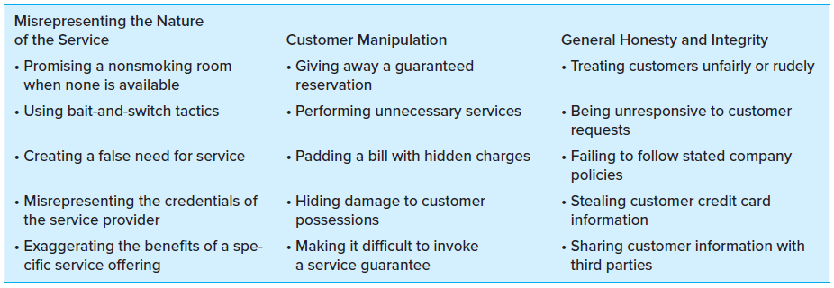
Contact personnel
Creating an ethical climate
  Customer-contact employees working without close supervision often are placed in situations where ethical standards might be compromised in an effort to serve multiple conflicting demands at the same time.
  Table 4.4: Examples of Unethical Behaviors in Customer-Contact Settings
  To promote ethical behavior, management should promote
    Formal control
      Enforcement of ethical codes, Punishment for ethical violation
    Informal control
      Discussion of ethics, Internalization of a code of ethics, ethical climate

Slide 27
The Customer
Every interaction is important for the customer, but is routine for the service provider. Therefore, the attitude and expectations may be different.
Expectations and Attitudes: classified 4 groups
  (1)Economizing customer
    Customer wants to maximize the value obtained for his or her expenditures of time, effort, and money.
    Loss of these customers is an early warning of potential competitive threats.
  (2)Ethical customer
    Patronize socially responsible firms
      Firms have developed a reputation for community service
  (3)Personalizing customer
    These customers want interpersonal gratification, ie recognition, respect..
  (4)Convenience customer
    These customers have no interest in shopping for the service; convenience is most important.

Slide 28
The Role of Scripts in Coproduction
Both customer and service provider have role to play in transacting the service.
Society has defined specific tasks for service customers to perform.
  Productive role, such as assembling meals and carrying them to table in a cafeteria, serving themselves at a salad bar
The customer is participating in the service delivery as a partial employee with a role to play and is following a script that is defined by societal norms or implied by the particular design of the service offered.
Acceptance of new technology that replaces a human service encounter can take time while customers learn the new script.
  Self-scanning checkout machines at supermarket.

Slide 29
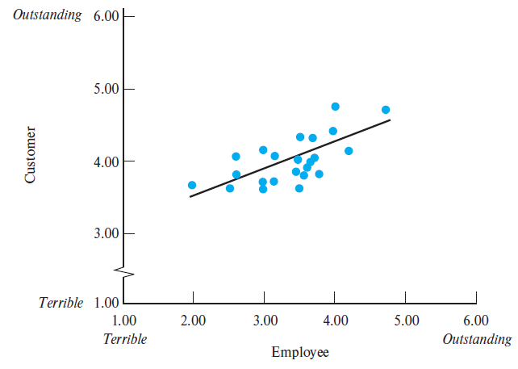
Creating a Customer Service Orientation
Employee Perceptions of Customer Service at 23 Branch Banks
A high correlation between customers’ and employees’ perceptions of service quality
Employee Q: How do you think the customers of your bank view the general quality of the service
Customer Q: Describe the general quality of the service received in your branch
Figure 4.3: Relationship between Customer and Employee Perceptions of Customer Service

Slide 30
Creating a Customer Service Orientation
Customers perceived better service in branches where employees reported:
  There is a more enthusiastic service emphasis.
  The branch manager emphasizes service as personnel perform their roles.
  There is an active effort to retain all customer accounts, not just those of large-account holders.
  The branch is staffed with sufficient and well-trained tellers.
  Equipment is well maintained, and supplies are plentiful.
When employees described branch as one where the manager emphasized customer service, customers reported superior service and:
  Tellers were courteous and competent.
  Staffing levels were adequate.
  The branch appeared to be well administered.
  Teller turnover was low.
  The staff had positive work attitudes.

Slide 31
Satisfaction Duality
More
repeat
purchases
More familiarity with customer needs and ways of meeting them
Stronger tendency to complain about service errors
Greater opportunity for recovery
from errors
Higher Customer Satisfaction
Higher Employee
Satisfaction
Lower Costs
Higher Productivity
Better Results
Improved Quality
of Service

Slide 32
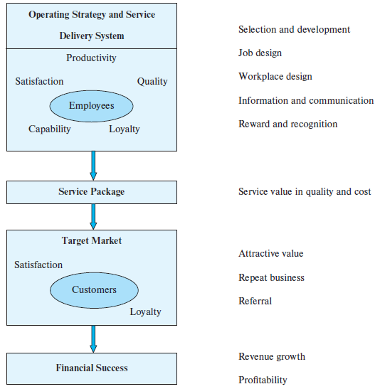
Figure 4.4: The Service Profit Chain proposes a relationship that links profitability, customer loyalty and service value to employee satisfaction, capability, and productivity

Slide 33
Service Profit Chain
1. Internal quality drives employee satisfaction
2. Employee satisfaction drives retention and productivity
3. Employee retention and productivity drives service value.
4. Service value drives customer satisfaction.
5. Customer satisfaction drives customer loyalty.
6. Customer loyalty drives profitability and growth.

Slide 34
1. Internal quality drive employee satisfaction
  USAA, a financial service company serving military community
    Telephone service representative is supported by a sophisticated information system that shows complete customer information when a customer gives member number
    Job related training in a resemble college campus setting
2. Employee satisfaction drive retention and productivity
    Employee turnover is the loss of productivity
    Southwest airlines high employee retention
      The most profitable airlines

Slide 35
3. Employee retention and productivity drives service value
  Southwest airlines
    Frequent departures
    On-time arrival
    Friendly employees
    Very low fare
    although
    does not assign seats, reservation not integrated with other airlines

Slide 36
4. Service value drives customer satisfaction
  Quality & productivity improvement yield high service quality and lower cost
5. Customer satisfaction drive customer loyalty
  Xerox found
    Very satisfied customers were 6 times more likely to repurchase
6. Customer loyalty drive profitability and growth
    5% increase in customer loyalty
    Produce a profit increase from 25 to 85%

Slide 37
Class discussion : Amy’s Ice Cream page 104-105
Describe the service organization culture at Amy’s Ice Cream.
What are the personality attributes of the employees who are sought by Amy’s Ice Cream?
Design a personnel selection procedure for Amy’s Ice Cream using abstract questioning, a situational vignette, or role playing.
4-<number>

Slide 38
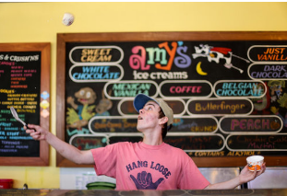
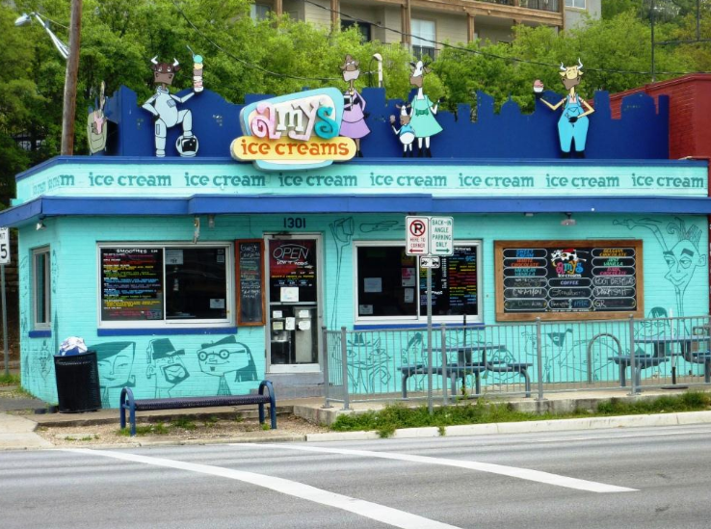

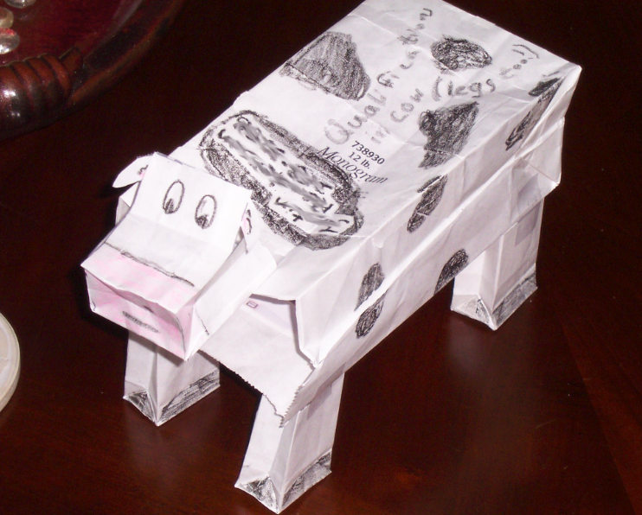
Amy’s Ice Cream Facility
4-<number>

